Slide 1
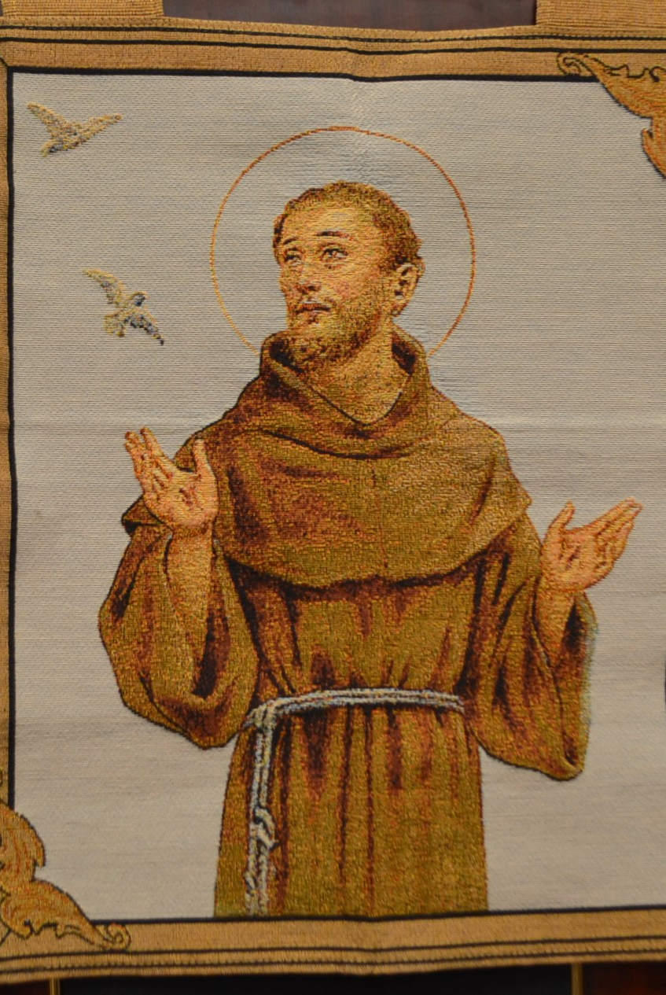
St. Maximilian Kolbe Fraternity
May 2, 2020
Gathering via Zoom

Slide 2
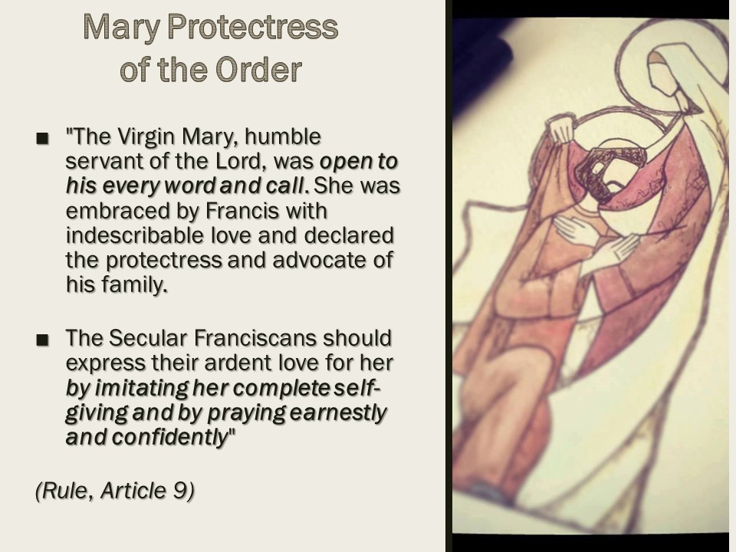

Slide 3
Questions for Sharing and Discussion
• What qualities of Mary are attractive to you?
• What is Mary’s role in our lives and in the life of the Church?
• What is the goal of devotion to Mary? How do you discern whether your devotion to Mary supports your Franciscan life?
• What example does Mary set for us as Secular Franciscans?

